Slide 1



STRATEGIC INTERVENTION REPORT
March 2026
OPERATIONS EXCELLENCE INITIATIVE
Digital Operations
Transformation
Optimizing Banking Operations Through Intelligent Automation and Process Excellence
Prepared by
Academic Program
Chukwuebuka Benjamin Obieli
Rome Business School
Assistant Head of Operations
Master's in Project Management 25APM2006OC97

Slide 2
NAVIGATION
Executive Overview
01
Executive Summary
02
Strategic Approach
Core value proposition, ROI projections, and strategic alignment
Project management framework and methodology selection
03
Gap Analysis
04
Innovation Opportunities
Current state assessment and root cause analysis
RPA, intelligent automation, and performance management
05
Implementation Roadmap
06
Stakeholder Engagement
Phased execution plan with milestones and resource allocation
Communication plan and change management strategy
07
Conclusion
Management recommendations and call to action
Strategic Insight
Data-driven recommendations for operational excellence

Slide 3
01 | EXECUTIVE SUMMARY
Strategic Value Proposition
Core Intervention
Investment Overview
This strategic intervention proposes a comprehensive Digital Operations Transformation initiative targeting Access Bank's operational efficiency through intelligent automation, process optimization, and performance management excellence. The initiative directly addresses critical gaps in legacy system integration, manual process inefficiencies, and change management challenges.
Initial Investment
$2.5M - $3.5M
ROI Timeline
18-24 Months
Cost Reduction
Efficiency Target
Implementation
30-40%
50-55%
18 Months
Operational cost savings through RPA implementation in high-volume processes
Cost-to-Income Ratio improvement to industry benchmark levels
Academic Foundation
Strategic Alignment
This intervention applies Rome Business School's Project Management competencies including stakeholder management, risk mitigation, Agile/Waterfall hybrid methodologies, and change management frameworks.
This initiative directly supports Access Bank's 2025-2027 Consolidation Phase objectives, leveraging technology as a growth platform while optimizing operations for enhanced shareholder value creation and positioning the bank as Africa's Gateway to the World.
Key Success Factors
Executive sponsorship and governance
Cross-functional collaboration
Structured change management
Continuous performance monitoring

Slide 4
STRATEGIC CONTEXT
Access Bank's Digital Journey
Recognition
2025-2027 Strategic Priorities
Nigeria's Best Transaction Bank 2025
1
Strategic Expansion Beyond Africa
Access Bank's leadership in Nigeria's transaction banking market reflects the scale of its digital transformation and the inclusiveness of its delivery model.
Data-driven insights, digitally enabled solutions, and targeted product offerings to enhance customer engagement and operational efficiency in high-growth regions.
2
Technology as Growth Platform
Enterprise-wide technology infrastructure enabling real-time transactions, integrated services, and agile responsiveness in a dynamic environment.
1.1B+
N157T
Transactions via Access More
Transaction Value (2024)
3
Operational Efficiency
Strengthen cost discipline and efficiency through shared-service integration and operational streamlining while defending margins and reinforcing cost leadership.
1.5M+
4.6★
New Users (2024)
App Store Rating
4
Talent-Driven Global Execution
Attracting, developing, and retaining skilled professionals to support global objectives and growth through innovation.
PrimusPlus Platform
Integrated corporate banking platform with end-to-end digital onboarding, salary disbursements, and real-time account visibility.
Vision: Africa's Gateway to the World
Delivering scalable earnings growth and optimizing capital efficiency

Slide 5
02 | STRATEGIC APPROACH
Project Management Framework
Hybrid Methodology Approach
Project Governance Structure
Combining PMI/PRINCE2 governance with Agile delivery for innovation components, ensuring structured control while maintaining flexibility for rapid adaptation.
Executive Steering Committee
MD/CEO sponsorship, strategic oversight, decision authority
Waterfall
Agile/Scrum
Compliance-heavy processes, regulatory reporting, audit trails
Customer-facing innovations, iterative development, rapid feedback
Project Management Office
Day-to-day coordination, resource management, reporting
Triple Constraint Management
Cross-Functional Teams
Operations, IT, Compliance, HR collaboration
Scope
Time
Budget
Vendor Partners
Clear deliverables
18-month timeline
$2.5M - $3.5M
RPA technology providers, implementation consultants
Quality & Risk Management
RBSN Competencies Applied
Continuous quality assurance and testing protocols
Stakeholder Management
Risk Management
Proactive risk identification and mitigation strategies
Agile Methodologies
Change Management
Regular stakeholder reviews and governance checkpoints
Quality Assurance
Performance Metrics

Slide 6
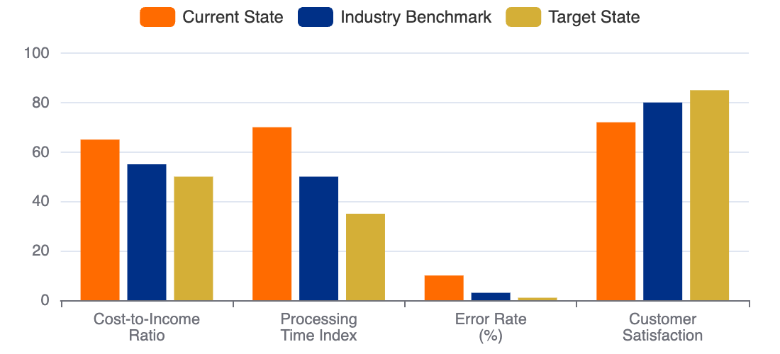
03 | GAP ANALYSIS
Current State Assessment
Critical Operational Challenges
Performance Metrics Gap
Legacy System Integration
Fragmented architecture creating data silos and limiting automation potential
Manual Process Dominance
60%+ of routine processes require manual intervention, increasing error rates
High Operational Costs
Cost-to-Income Ratio above industry benchmark (target: 50-55%)
KYC/Onboarding Cost Impact
Processing Efficiency Comparison
$52M
Account Onboarding
5-7 days → 1-2 days
Average annual cost for KYC compliance in large banks, with significant manual processing overhead and extended customer onboarding timelines.
Loan Processing
2-3 weeks → 3-5 days
KYC Verification
3-5 days → Same day
Skills & Talent Gaps
Error Rate Analysis
Shortage of AI and machine learning expertise
Limited data science capabilities for analytics
8-12%
<1%
Change resistance due to inadequate training
Manual Data Entry
Automated Systems

Slide 7
03 | GAP ANALYSIS
Root Cause Analysis
Five Core Issues Identified
4
1
Fragmented Technology Architecture
Insufficient Performance Metrics
Legacy systems operating in silos create data inconsistencies and limit cross-functional visibility. Integration challenges between core banking platforms and digital channels result in manual workarounds.
Lack of standardized KPIs to measure transformation success and operational efficiency improvements.
Impact: High
Complexity: High
Evidence
Limited visibility into process-level performance and ROI tracking
2
Excessive Manual Intervention
Over 60% of routine processes require manual data entry, validation, or approval, creating bottlenecks and increasing error rates. Staff time consumed by repetitive tasks limits focus on value-added activities.
5
Impact: High
Complexity: Medium
Organizational Change Resistance
Staff reluctance to adopt new digital tools due to inadequate communication, training, and change management support.
3
Critical Skills Gap
Shortage of professionals with expertise in AI, machine learning, data science, and automation technologies. Limited internal capability to design, implement, and maintain digital transformation initiatives.
Evidence
Low adoption rates for new systems, feedback from employee surveys
Impact: Medium
Complexity: High
Key Insight
These interconnected issues create a compound effect, where each problem amplifies others. Addressing them requires a holistic, integrated approach rather than isolated fixes.

Slide 8
04 | INNOVATION OPPORTUNITIES
Robotic Process Automation (RPA)
RPA Implementation Strategy
Implementation Complexity Matrix
Deploying software robots to automate repetitive, rule-based tasks, reducing processing time by 30-70% and minimizing human error. McKinsey research indicates up to 30% of banking tasks can be automated through RPA.
KYC Automation
Low
High ROI, well-defined rules, clear compliance requirements
30-70%
60%+
Account Onboarding
Medium
Cost Reduction
Error Reduction
Multiple system integration, regulatory validation
Loan Processing
Medium
KYC Verification
Loan Processing
Complex decision trees, credit risk assessment
Current:
3-5 days
Current:
2-3 weeks
High
Target:
Same day
Target:
3-5 days
Fraud Detection
Impact: 70% time reduction, automated background checks, document verification
Impact: Automated data extraction, credit checks, eligibility assessment
AI/ML integration, real-time processing, high security
Account Onboarding
Fraud Detection
Recommended Approach
Current:
5-7 days
Current:
Batch processing
Start with high-impact, low-complexity processes (KYC, onboarding) to demonstrate quick wins, then scale to more complex automation (loan processing, fraud detection).
Target:
1-2 days
Target:
Real-time
Impact: 80% automation of data entry, validation, system integration
Impact: Continuous monitoring, pattern recognition, instant alerts
Technology Partners
UiPath
Automation Anywhere
Blue Prism

Slide 9
04 | INNOVATION OPPORTUNITIES
Intelligent Process Optimization
AI & Advanced Analytics
Integration with Existing Platforms
Leveraging artificial intelligence, machine learning, and predictive analytics to transform decision-making, enhance customer experiences, and optimize operational performance beyond basic automation.
Access More App
Enhance with AI-powered financial insights, personalized recommendations, and chatbot support
PrimusPlus Platform
Predictive Analytics
Conversational AI
Integrate intelligent analytics for corporate clients, automated reporting, and predictive cash flow management
Predictive Credit Decisioning
Core Banking System
API-first integration ensuring seamless data flow and real-time synchronization across all channels
AI models analyze alternative data (income patterns, spending behavior, digital footprint) for faster, fairer lending decisions while reducing default risk.
35% faster approvals
20% lower defaults
Human + Machine Collaboration
AI enhances rather than replaces human expertise, enabling staff to focus on high-value advisory roles, complex problem-solving, and relationship building while automation handles routine tasks.
Intelligent Document Processing
AI-powered OCR and NLP extract, classify, and validate information from trade finance documents, contracts, and forms with 95%+ accuracy.
90% time reduction
95% accuracy
Key Capabilities
Real-time analytics
Pattern recognition
Natural language processing
Predictive modeling

Slide 10
04 | INNOVATION OPPORTUNITIES
Performance Management System
Comprehensive KPI Dashboard
Balanced Scorecard Approach
Real-time performance monitoring system providing executive visibility into operational efficiency, financial performance, and transformation progress through integrated data visualization and automated reporting.
Financial
CIR, ROA, cost savings
Customer
NPS, satisfaction, retention
Real-time
360°
Internal Process
Efficiency, quality, speed
Data Updates
Performance View
Learning & Growth
Skills, adoption, innovation
Key Performance Indicators
Dashboard Features
Cost-to-Income Ratio
Processing Time
Executive summary views
50-55%
-50%
Drill-down capabilities
Automated alerts & notifications
From current 65%
Across key processes
Benchmarking comparisons
Trend analysis & forecasting
Error Rate
Customer NPS
-60%
+13 pts
Through automation
Target: 85 score
Strategic Alignment
KPIs directly linked to Access Bank's 2025-2027 consolidation objectives and shareholder value creation goals.

Slide 11
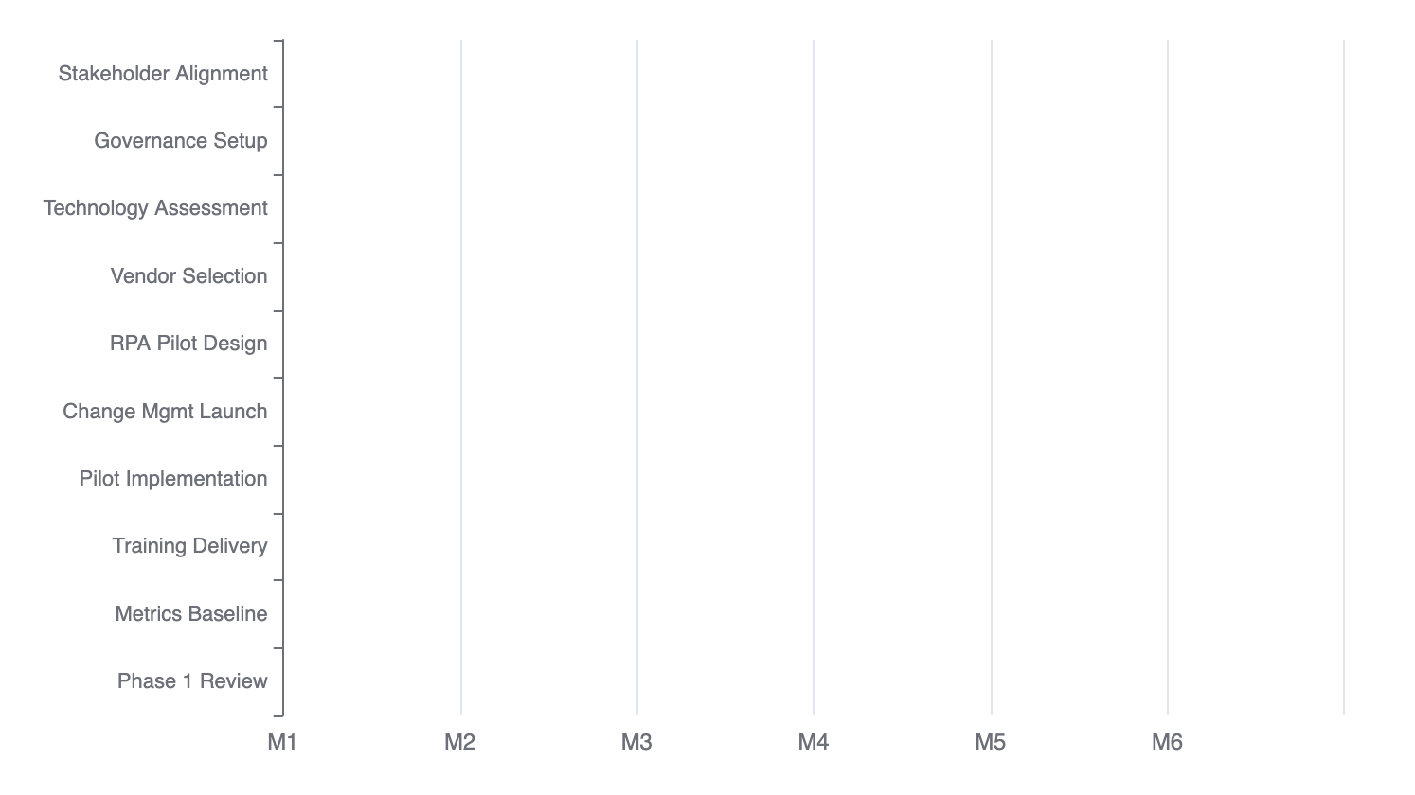
05 | IMPLEMENTATION ROADMAP
Phase 1: Foundation (Months 1-6)
Phase 1 Activities & Milestones
Phase 1 Objectives
Establish governance structure
Launch pilot RPA implementation
Initiate change management
Baseline performance metrics
Resource Requirements
Project Team:
8-10 FTEs
Budget:
$800K - $1M
Vendor Support:
RPA Partner
Success Criteria
Steering committee operational
2-3 RPA processes deployed
Training program launched
Baseline metrics established
Risk Mitigation
Early stakeholder engagement, phased rollout approach, and dedicated change management resources to minimize resistance.

Slide 12
05 | IMPLEMENTATION ROADMAP
Phase 2 & 3: Scale-Up & Optimization
Phase 2: Scale-Up (M7-12)
Phase 3: Optimization (M13-18)
Expand RPA Deployment
Full Process Automation
Loan processing, account management, regulatory reporting automation
Complete RPA rollout across all identified processes, integration optimization
Deploy Intelligent Analytics
Advanced AI Integration
AI-powered credit decisioning, predictive analytics, customer insights
Machine learning models, natural language processing, intelligent automation
Implement Performance Dashboard
Continuous Improvement
Real-time KPI monitoring, executive reporting, benchmarking
Process refinement, performance optimization, innovation pipeline
Mid-Program Review
Benefits Realization
Benefits assessment, course correction, stakeholder updates
Comprehensive ROI assessment, value quantification, success documentation
Phase 2 Investment
Phase 3 Investment
$1.2M
12-15
$800K
10-12
Budget
Team Size
Budget
Team Size
Total Program Timeline: 18 Months
Total Investment: $2.5M - $3.5M | Expected ROI: 18-24 months payback | Annual Savings: $4M - $6M (from Year 2)

Slide 13
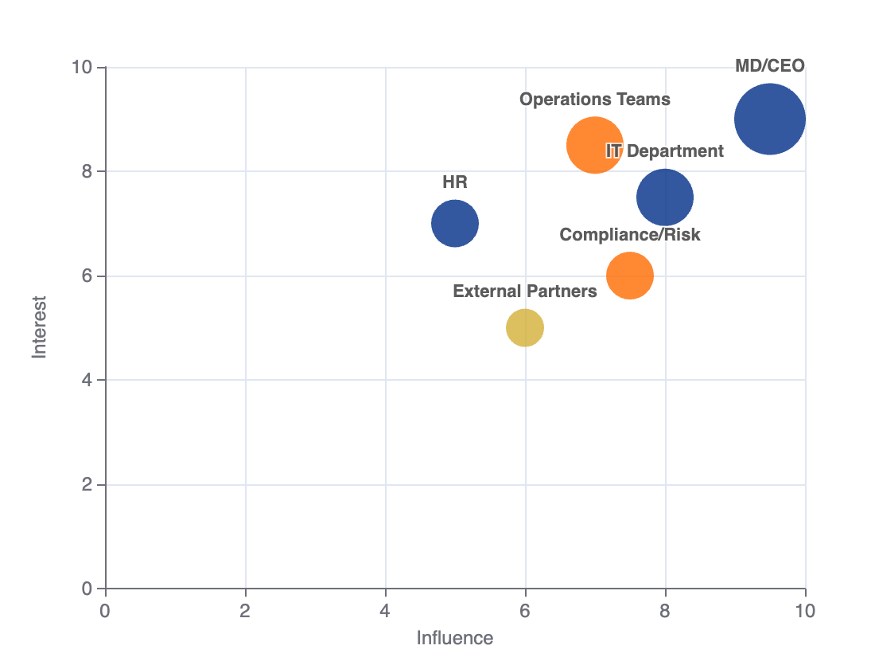
06 | STAKEHOLDER ENGAGEMENT
Stakeholder Engagement Strategy
Stakeholder Mapping Matrix
Key Stakeholder Groups
Executive Leadership
MD/CEO, C-Suite - Strategic oversight, decision authority, resource allocation
Operations Teams
Branch managers, process owners - End-users, implementation support, feedback
IT Department
Technical implementation, system integration, security compliance
Compliance & Risk
Regulatory oversight, risk assessment, audit requirements
Engagement Tactics
Executive steering committee (monthly)
Cross-functional working groups (weekly)
Town hall sessions (quarterly)
Training programs (ongoing)
Communication Cadence
Weekly updates
Bi-weekly meetings
Monthly reports
Escalation protocols

Slide 14
06 | STAKEHOLDER ENGAGEMENT
Change Management & Communication Plan
Prosci ADKAR Model Implementation
Training Curriculum
Structured change management approach ensuring individual transitions align with organizational transformation goals, maximizing adoption and minimizing resistance.
Leadership Training
Change management, sponsorship, communication
Technical Training
RPA tools, analytics platforms, new systems
A
D
K
A
R
Awareness
Desire
Knowledge
Ability
Reinforcement
End-User Training
Communicate urgency and benefits
Engage and empower employees
Comprehensive training programs
Hands-on practice and support
Recognition and continuous improvement
System navigation, process changes, best practices
Continuous Learning
E-learning modules, refresher courses, certifications
Communication Strategy
Multi-Channel Approach
Feedback Mechanisms
Resistance Management
• Email communications
• Regular surveys
• Intranet portal updates
• Focus group sessions
Early identification of concerns
• Workshop sessions
• Suggestion boxes
Proactive communication
• One-on-one discussions
• Open door policy
Champion network development
Incentive alignment
Success Metrics
90%+
80%+
Training completion
User adoption

Slide 15
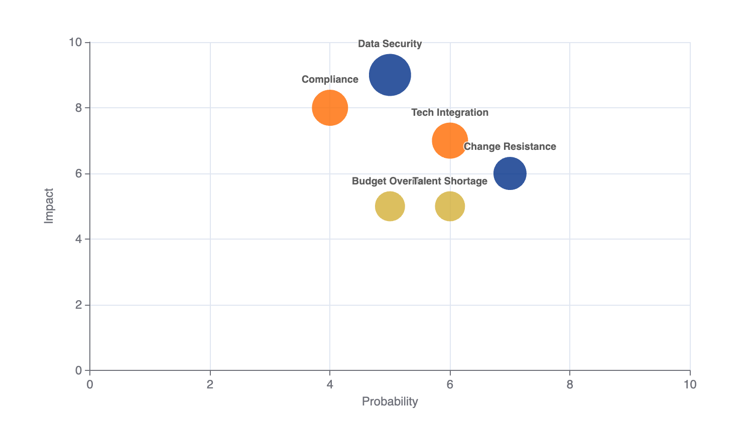
RISK MANAGEMENT
Risk Assessment & Mitigation
Risk Matrix & Mitigation Strategies
Key Risk Categories
Technology Integration
Legacy system compatibility, data migration
Data Security
Cyber threats, data breaches, privacy
Regulatory Compliance
NDPA, CBN requirements, audit trails
Change Resistance
Employee adoption, skill gaps
Risk Monitoring
Weekly risk reviews
Risk register updates
Escalation protocols
Contingency planning
Regulatory Alignment
All initiatives aligned with Access Bank's risk management framework and CBN regulatory requirements.

Slide 16
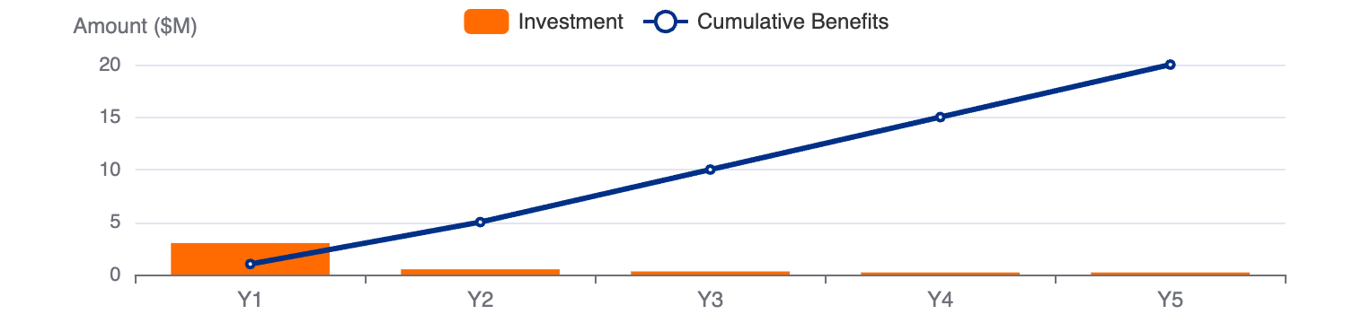
BENEFITS REALIZATION
Expected Benefits & ROI Analysis
Benefits Realization Framework
Investment Summary
Operational Benefits
Strategic Benefits
Total Investment
$2.5M - $3.5M
• 30-40% cost reduction
• Competitive positioning
• 50-60% faster processing
• Scalability for growth
ROI Timeline
18-24 months
• 60% error rate reduction
• Innovation leadership
• Improved CIR to 50-55%
• Talent attraction
Annual Savings (Y2+)
$4M - $6M
Customer Benefits
Risk Benefits
5-Year NPV
$12M - $18M
• Faster service delivery
• Enhanced compliance
• Enhanced experience
• Better fraud detection
• 24/7 availability
• Improved audit trails
• NPS improvement
• Reduced human error
Sensitivity Analysis
Conservative (70% benefits)
ROI: 150%
Financial Analysis
Base Case (100% benefits)
ROI: 220%
Optimistic (130% benefits)
ROI: 290%
Value Creation
Initiative directly supports Access Bank's shareholder value creation goals and 2025-2027 consolidation strategy.

Slide 17
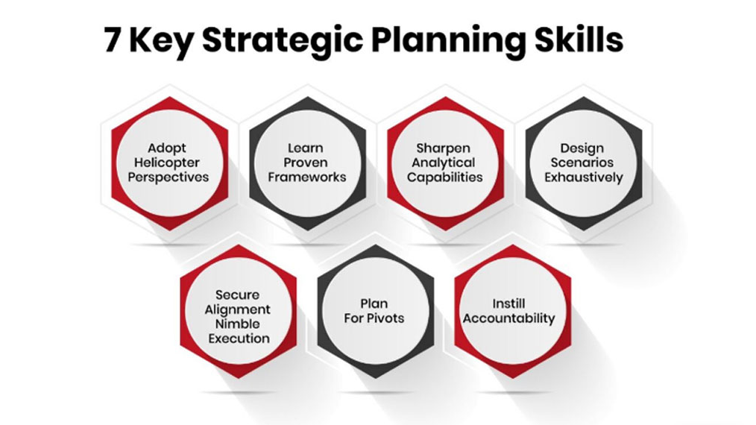
07 | CONCLUSION
Strategic Intervention Report
Management Recommendations
1
Approve Phase 1 Pilot Implementation
Allocate dedicated budget ($800K - $1M) and resources (8-10 FTEs) to launch the foundation phase. Establish executive steering committee with MD/CEO sponsorship to ensure organizational commitment and rapid decision-making.
2
Establish Cross-Functional Governance
Form integrated project team spanning Operations, IT, Compliance, and HR with clear roles, responsibilities, and decision-making authority. Implement structured governance with monthly steering committee reviews and weekly working group sessions.
3
Integrate into Digital Transformation Roadmap
Align this initiative with Access Bank's broader 2025-2027 consolidation strategy and technology investment priorities. Ensure coordination with existing digital platforms (Access More, PrimusPlus) to maximize synergies and avoid duplication.
18-24
$4-6M
30-40%
Months to ROI
Annual Savings
Cost Reduction
Call to Action
The window of opportunity is now. Competitors are rapidly adopting automation and AI. Delaying this initiative risks losing competitive advantage and operational efficiency gains. Approve Phase 1 commencement within 30 days to maintain Access Bank's leadership position as Africa's Gateway to the World.
Prepared by: Chukwuebuka Benjamin Obieli | Assistant Head of Operations
Rome Business School - Master's in Project Management | March 2026

